Slide 1
Parallel Organization

Slide 2
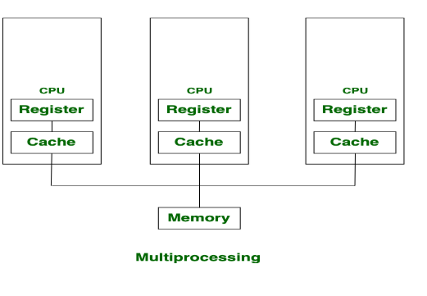
Multiprocessing
Multiprocessing is a system that has two or more than one processors.
In this, CPUs are added for increasing computing speed of the system.
Hence there are many processes that are executed simultaneously.

Slide 3
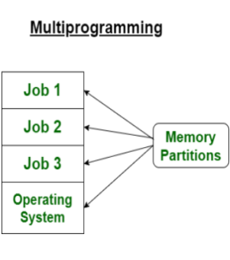
Multiprogramming
Multi-programming is more than one process running at a time,
It increases CPU utilization by organizing jobs (code and data) so that the CPU always has one to execute.
The motive is to keep multiple jobs in main memory. If one job gets occupied with Input/output, CPU can be assigned to other job.

Slide 4
S.No. | Multiprocessing | Multiprogramming
1. | The availability of more than one processor per system, that can execute several set of instructions in parallel is known as multiprocessing. | The concurrent application of more than one program in the main memory is known as multiprogramming.
2. | The number of CPU is more than one. | The number of CPU is one.
3. | It takes less time for job processing. | It takes more time to process the jobs.
4. | In this, more than one process can be executed at a time. | In this, one process can be executed at a time.
5. | It is economical. | It is economical.
6. | The number of users is can be one or more than one. | The number of users is one at a time.
7. | Throughput is maximum. | Throughput is less.
8. | Its efficiency is maximum. | Its efficiency is Less.

Slide 5
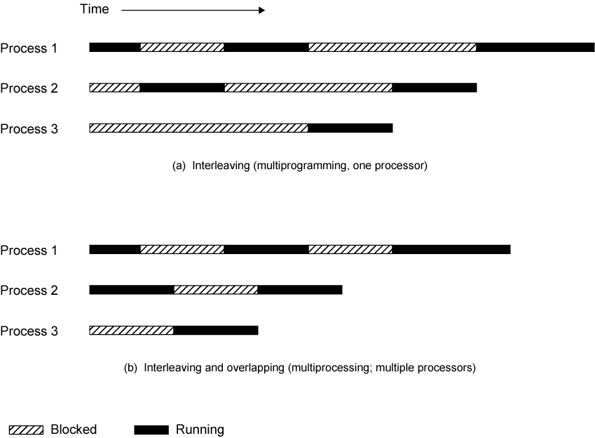
Multiprogramming and Multiprocessing

Slide 6
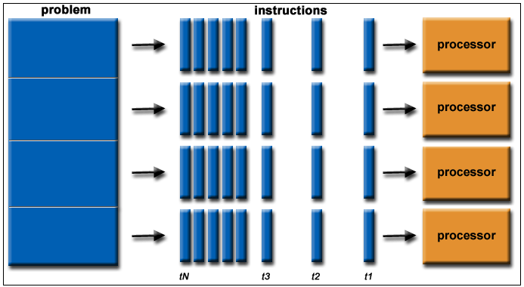
Parallel Processing
Parallel processing is a method of simultaneously breaking up and running program tasks on multiple microprocessors, thereby reducing processing time.
Parallel processing may be accomplished via a computer with two or more processors or via a computer network. Parallel processing is also called parallel computing.

Slide 7
Flynn’s Taxonomy -Multiple Processor Organization
Single instruction, single data stream - SISD
Single instruction, multiple data stream - SIMD
Multiple instruction, single data stream - MISD
Multiple instruction, multiple data stream- MIMD

Slide 8
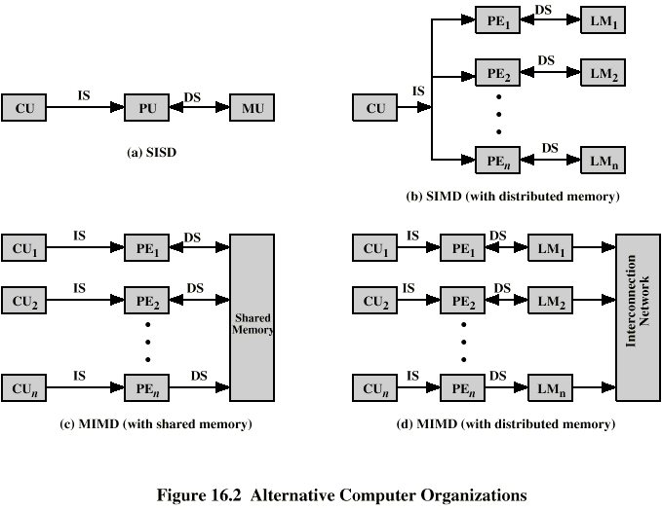
Single Instruction, Single Data Stream - SISD
Single processor
Single instruction stream
Data stored in single memory
Uni-processor
CU-Control Unit
PU-Processing Unit
MU-Memory Unit

Slide 9
Single Instruction, Multiple Data Stream - SIMD
Single machine instruction
Controls simultaneous execution
Number of processing elements
Lockstep basis (Lockstep systems are fault-tolerant computer systems that run the same set of operations at the same time in parallel.)
Each processing element has associated data memory
Each instruction executed on different set of data by different processors
CU-Control Unit
PE-Processing Element
LM-Local Memory

Slide 10
Multiple Instruction, Single Data Stream - MISD
Sequence of data
Transmitted to set of processors
Each processor executes different instruction sequence
Never been implemented

Slide 11
Multiple Instruction, Multiple Data Stream- MIMD
Set of processors
Simultaneously execute different instruction sequences
Different sets of data
SMPs, clusters and NUMA systems

Slide 12
MIMD - Overview
General purpose processors
Each can process all instructions necessary
Further classified by method of processor communication
Shared Memory
Distributed Memory

Slide 13
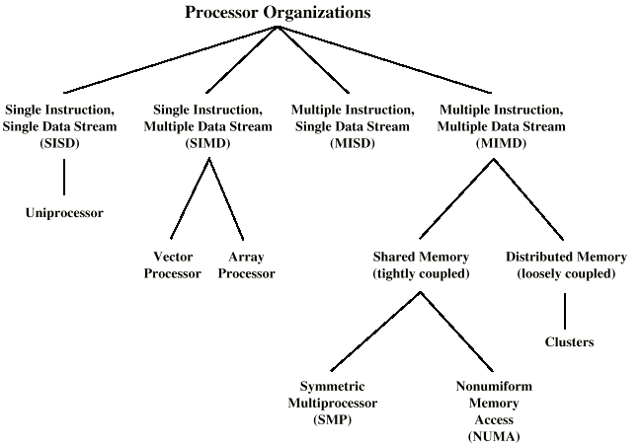
Taxonomy of Parallel Processor Architectures

Slide 14
Tightly Coupled - SMP
Processors share memory
Communicate via that shared memory
Symmetric Multiprocessor (SMP)
Share single memory or pool
Shared bus to access memory
Memory access time to given area of memory is approximately the same for each processor

Slide 15
Shared Memory Multiprocessors

Slide 16
Loosely Coupled - Clusters
Collection of independent uniprocessors or SMPs
Interconnected to form a cluster
Communication via fixed path or network connections

Slide 17
Symmetric Multiprocessors
A stand alone computer with the following characteristics
Two or more similar processors of comparable capacity
Processors share same memory and I/O
Processors are connected by a bus or other internal connection
Memory access time is approximately the same for each processor
All processors share access to I/O
Either through same channels or different channels giving paths to same devices
All processors can perform the same functions (hence symmetric)
System controlled by integrated operating system
providing interaction between processors
Interaction at job, task, file and data element levels

Slide 18
SMP Advantages
Performance
If some work can be done in parallel
Availability
Since all processors can perform the same functions, failure of a single processor does not halt the system
Incremental growth
User can enhance performance by adding additional processors
Scaling
Vendors can offer range of products based on number of processors

Slide 19
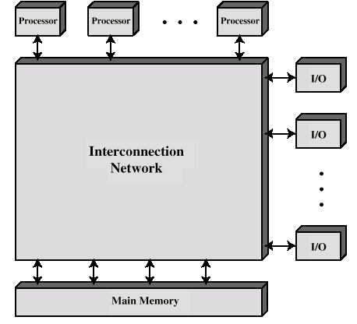
Block Diagram of Tightly Coupled Multiprocessor

Slide 20
Time Shared Bus
Simplest form
Structure and interface similar to single processor system
Following features provided for DMA transfers from I/O sub-system to processsor
Addressing - distinguish modules on bus
Arbitration - any module can be temporary master
Time sharing - if one module has the bus, others must wait and may have to suspend
Now have multiple processors as well as multiple I/O modules

Slide 21
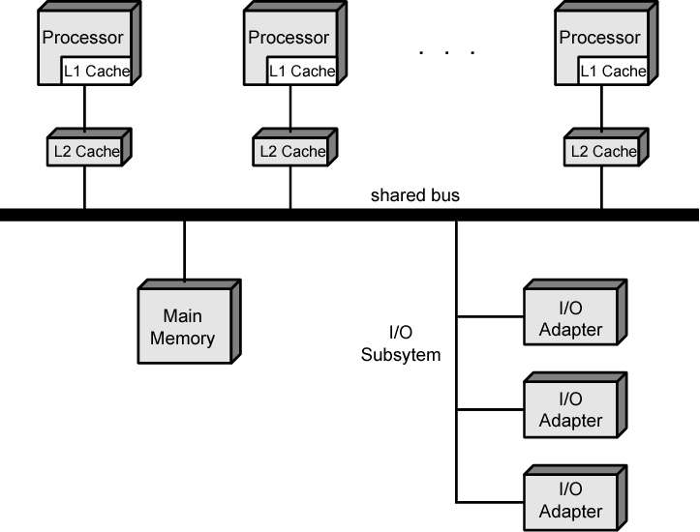
Symmetric Multiprocessor Organization

Slide 22
Time Share Bus - Advantages
Simplicity
Flexibility
Reliability

Slide 23
Time Share Bus - Disadvantage
Performance limited by bus cycle time
Each processor should have local cache
Reduce number of bus accesses
Leads to problems with cache coherence
Solved in hardware - see later

Slide 24
Operating System Issues
Simultaneous concurrent processes
Scheduling
Synchronization
Memory management
Reliability and fault tolerance

Slide 25
Cache Coherence
Problem - multiple copies of same data in different caches
Can result in an inconsistent view of memory
Write back policy can lead to inconsistency
Write through can also give problems unless caches monitor memory traffic

Slide 26
Software Solutions
Compiler and operating system deal with problem
Overhead transferred to compile time
Design complexity transferred from hardware to software
However, software tends to make conservative decisions
Inefficient cache utilization
Analyze code to determine safe periods for caching shared variables

Slide 27
Hardware Solution
Cache coherence protocols
Dynamic recognition of potential problems
Run time
More efficient use of cache
Transparent to programmer
There are 2 hardware schemes:
Directory protocols
Snoopy protocols

Slide 28
Directory Protocols
Collect and maintain information about copies of data in cache
Directory stored in main memory
Requests are checked against directory
Appropriate transfers are performed
Creates central bottleneck
Effective in large scale systems with complex interconnection schemes

Slide 29
Snoopy Protocols
Distribute cache coherence responsibility among cache controllers
Cache recognizes that a line is shared
Updates announced to other caches
Suited to bus based multiprocessor
Increases bus traffic
Two approaches to Snoopy protocols
Write Invalidate (MESI protocol)
Write Update

Slide 30
Write Invalidate
Multiple readers, one writer
When a write is required, all other caches of the line are invalidated
Writing processor then has exclusive access until line required by another processor
Used in Pentium II and PowerPC systems
State of every line is marked as modified, exclusive, shared or invalid

Slide 31
Write Update
Multiple readers and writers
Updated word is distributed to all other processors
Some systems use an adaptive mixture of both solutions

Slide 32
MESI Protocol
For MESI, the data cache includes two status bits per tag, so that each line can be in one of four states:
Modified: The line in the cache has been modified (different from main memory) and is available only in this cache.
Exclusive: The line in the cache is the same as that in main memory and is not present in any other cache.
Shared: The line in the cache is the same as that in main memory and may be present in another cache.
Invalid: The line in the cache does not contain valid data.

Slide 33
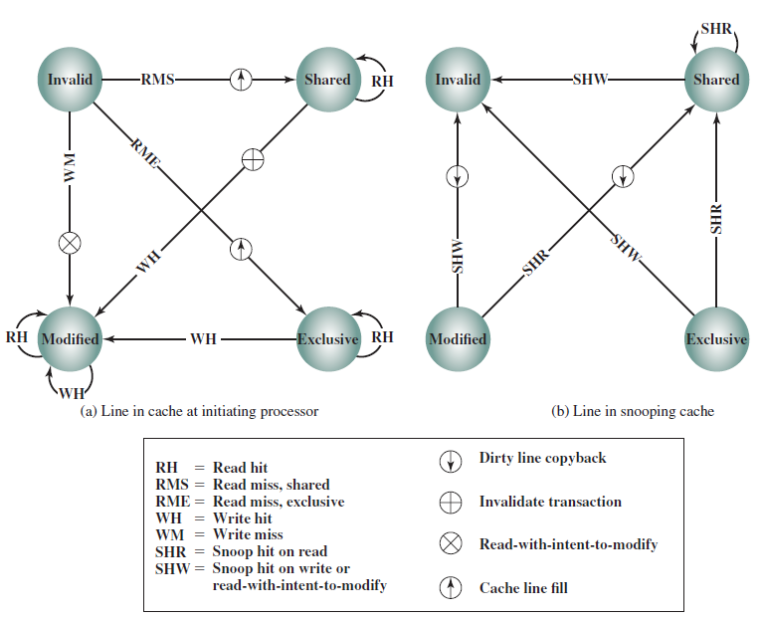
MESI Protocol State Transitions

Slide 34
In case of Read Miss
If one other cache has a clean (unmodified since read from memory) copy of the line in the exclusive state, it returns a signal indicating that it shares this line. The responding processor then transitions the state of its copy from exclusive to shared, and the initiating processor reads the line from main memory and transitions the line in its cache from invalid to shared.
If one or more caches have a clean copy of the line in the shared state, each of them signals that it shares the line. The initiating processor reads the line and transitions the line in its cache from invalid to shared.
If one other cache has a modified copy of the line, then that cache blocks the memory read and provides the line to the requesting cache over the shared bus. The responding cache then changes its line from modified to shared. The line sent to the requesting cache is also received and processed by the memory controller, which stores the block in memory.
If no other cache has a copy of the line (clean or modified), then no signals are returned. The initiating processor reads the line and transitions the line in its cache from invalid to exclusive.

Slide 35
In case of Read Hit
When a read hit occurs on a line currently in the local cache, the processor simply reads the required item. There is no state change: The state remains modified, shared, or exclusive.

Slide 36
In case of Write Miss
When a write miss occurs in the local cache, the processor initiates a memory read to read the line of main memory containing the missing address. For this purpose, the processor issues a signal on the bus that means read- with- intent- to- modify (RWITM).
When the line is loaded, it is immediately marked modified.With respect to other caches, two possible scenarios precede the loading of the line of data
Some other cache may have a modified copy of this line (state = modify).
No other cache has a modified copy of the requested line.

Slide 37
In case of Write Hit
When a write hit occurs on a line currently in the local cache, the effect depends on the current state of that line in the local cache:
Shared: Before performing the update, the processor must gain exclusive ownership of the line. The processor signals its intent on the bus. Each processor that has a shared copy of the line in its cache transitions the sector from shared to invalid. The initiating processor then performs the update and transitions its copy of the line from shared to modified.
Exclusive: The processor already has exclusive control of this line, and so it simply performs the update and transitions its copy of the line from exclusive to modified.
Modified: The processor already has exclusive control of this line and has the line marked as modified, and so it simply performs the update.

Slide 38
MESI Protocol State Transitions

Slide 39
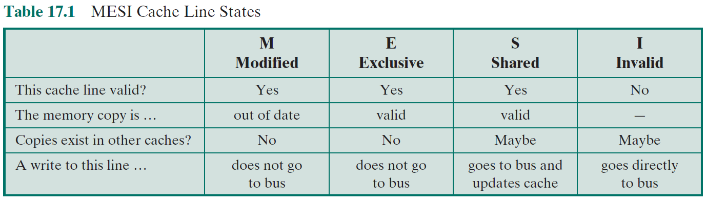
MESI Cache Line States

Slide 40
Multicore Organization

Slide 41
Hardware Performance Issues
Microprocessors have seen an exponential increase in performance
Improved organization
Increased clock frequency
Increase in Parallelism
Pipelining
Superscalar
Simultaneous multithreading (SMT)
Diminishing returns
More complexity requires more logic
Increasing chip area for coordinating and signal transfer logic
Harder to design, make and debug

Slide 42
Alternate Chip Organization
Superscalar
Simultaneous multithreading
Multicore

Slide 43
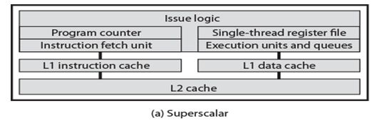
Superscalar processor
A superscalar processor is a CPU that implements a form of parallelism called instruction-level parallelism within a single processor.
In contrast to a scalar processor that can execute at most one single instruction per clock cycle, a superscalar processor can execute more than one instruction during a clock cycle by simultaneously dispatching multiple instructions to different execution units on the processor.
It therefore allows for more throughput (the number of instructions that can be executed in a unit of time) than would otherwise be possible at a given clock rate. Each execution unit is not a separate processor (or a core if the processor is a multi-core processor), but an execution resource within a single CPU such as an arithmetic logic unit.

Slide 44
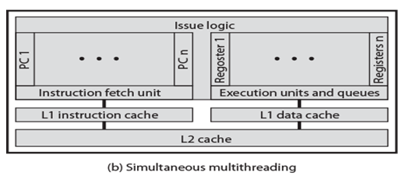
Simultaneous multithreading (SMT)
Simultaneous multithreading (SMT) is a technique for improving the overall efficiency of superscalar CPUs with hardware multithreading. SMT permits multiple independent threads of execution to better utilize the resources provided by modern processor architectures.

Slide 45
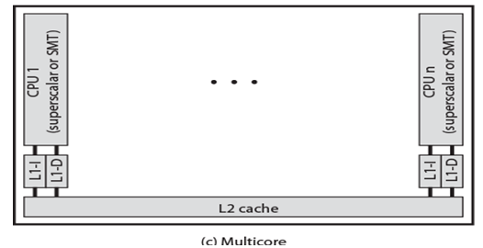
Multicore
Multicore refers to an architecture in which a single physical processor incorporates the core logic of more than one processor.
A single integrated circuit is used to package or hold these processors.
These single integrated circuits are known as a die.
Multicore architecture places multiple processor cores and bundles them as a single physical processor.
The objective is to create a system that can complete more tasks at the same time, thereby gaining better overall system performance.

Slide 46
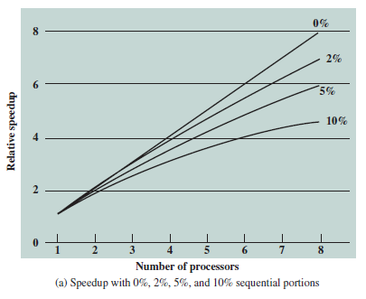
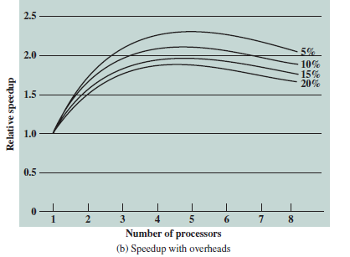
Software Performance Issues
Performance benefits dependent on effective exploitation of parallel resources

Slide 47
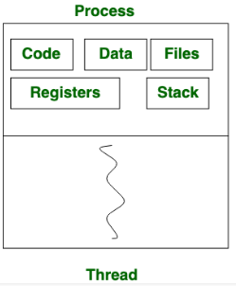
What is a Process and a what is a Thread?
Process means any program is in execution. Process control block controls the operation of any process.
Thread is the segment of a process means a process can have multiple threads and these multiple threads are contained within a process

Slide 48
Thread Level Parallelism
Thread-level parallelism (TLP) is the parallelism inherent in an application that runs multiple threads at once.
This type of parallelism is found largely in applications written for commercial servers such as databases.
Task parallelism (also known as Thread level parallelism, function parallelism and control parallelism) is a form of parallel computing for multiple processors using a technique for distributing execution of processes and threads across different parallel processor nodes.

Slide 49
Process Level Parallelism
Multiprocess applications are characterized by the presence of many single threaded processes.
Application Level Parallelism
Running multiple instances of the application in parallel

Slide 50
Multicore Organization
Number of core processors on chip
Number of levels of cache on chip
Amount of shared cache
Next slide examples of each organization:
(a) ARM11 MPCore
(b) AMD Opteron
(c) Intel Core Duo
(d) Intel Core i7

Slide 51
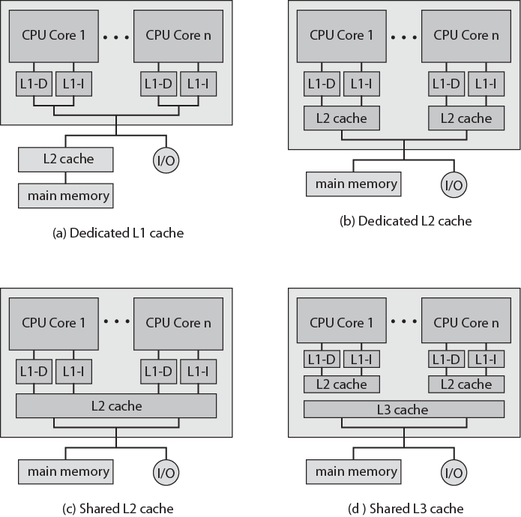
Multicore Organization Alternatives

Slide 52
Homogenous multicore organization
Homogeneous multicore systems have more than one core and share the same architecture and microarchitecture.
Example of this is the Arm quad-core Cortex-A53 system;
Each core is identical in this system..

Slide 53
Heterogeneous multicore
Heterogeneous multicore systems have two or more cores that differ in architecture or microarchitecture
Example of heterogeneous multicore systems is the combination of a microprocessor core with a microcontroller class core (for example, mix of Cortex-A, Cortex-M or DSP cores
two approaches to heterogeneous multicore organization.
Different Instruction Set Architectures (CPU/GPU multicore, CPU/DSP multicore)
Equivalent Instruction Set Architectures

Slide 54
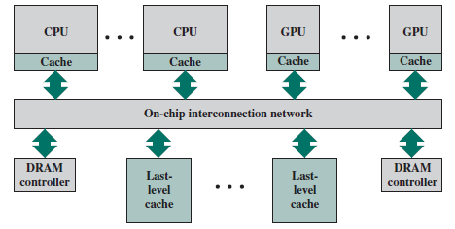
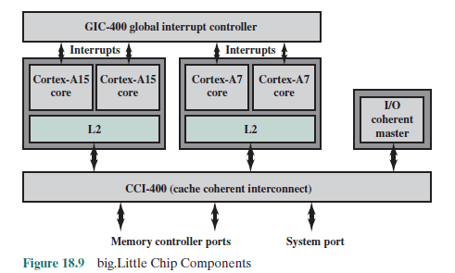

Slide 55
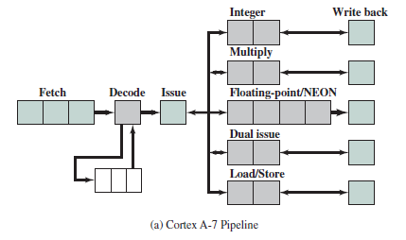

Slide 56
